Slide 1
HTML & CSS
…or how to build a website
Benjamin Mai

Slide 2
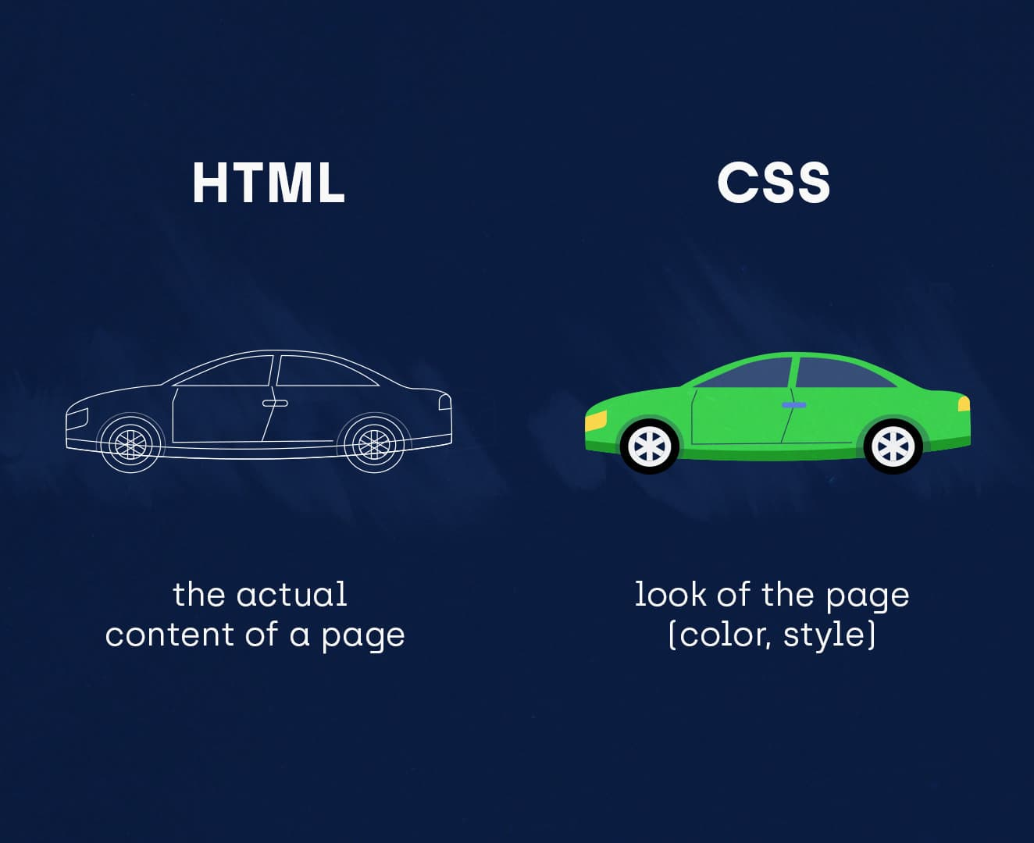
What are HTML and CSS?
Short introduction
HTML = Hypertext Markup Language
CSS = Cascading Style Sheets
HTML is used to build the website, CSS is responsible for design
Notes:
Ensure the titles are not duplicated. Please check the set of best practices.

Slide 3
HTML
Notes:
Including Accenture word

Slide 4
Hypertext Markup Language
Basics
HTML documents are generally structures into 3 parts:
<!DOCTYPE html>
<html>
<head>
<meta charset="UTF-8">
<title>Page Title</title>
<meta name="viewport" content="width=device-width, initial-scale=1.0">
<Additional metadata and resources can be inserted here >
</head>
<body>
< Content such as images, links, text, etc. can be inserted here >
</body>
</html>
The doctype definition
The head of the document where information is placed, e.g., title, language, date, but also meta information like device scaling, icon usage,…
The body of the document, where the information is placed which is being displayed within the browser
Notes:
Nutzt Tags um Content einer Web Page zu strukturieren und Elemente zu definineren
Diese Tags werden in Brackets geschrieben -> wie ihr sie hier seht
HTML Dokumete sind generell in 3 Parts aufgeteilt
Head -> Informationen stehen da drinnen wie Titel, Sprache, Datum, Device Scaling usw
Body -> Inhalt der Seite die im Browser angezeigt wird

Slide 5
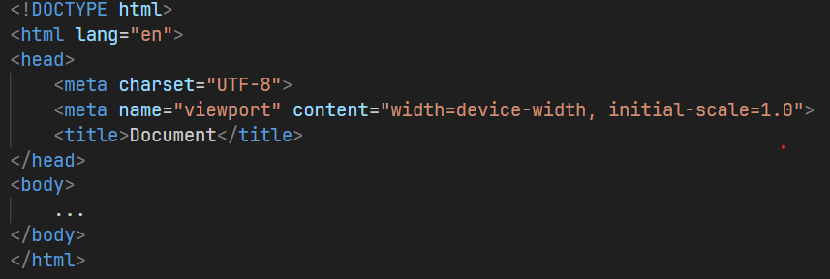
Hypertext Markup Language
HTML in VS Code
Can be automatically created in VS Code by typing a single ‘!’ end clicking Enter
Notes:
Every HTML file needs this structure
Show automatic creation
Content in Body

Slide 6
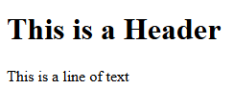
Tags
Tags
HTML uses tags to define and structure content.
They indicate how elements should be displayed and function within a web page.
Structure:
<tag>Content</tag>
Example:
<h1>This is a Header</h1>
<p>This is a line of text</p>
Notes:
Tags erklären (öffnender Tag und schließender Tag)

Slide 7
Tags
Tags
Opening and Closing Tags
Most tags come in pairs: opening (<tag>) and closing (</tag>).
Content between opening and closing tags is affected by the tag's purpose.
Purpose of Tags
Structuring Content: Tags define the layout and hierarchy of elements on a page.
Semantic Meaning: Some tags convey specific meanings (e.g., headings, paragraphs).
Formatting: Tags control text formatting, such as bold (<strong>) or italic (<em>).
Embedding Media: Tags like <img> embed images, enhancing visual content.
Linking: The <a> tag creates hyperlinks to other resources or pages.
Notes:
Tags werden in Brackets geschrieben -> gibt die Struktur des Web Inhalts an
Sie zeige an wie die Elemente auf der Website angezeigt werden und welche Funktion sie erfüllen sollen

Slide 8
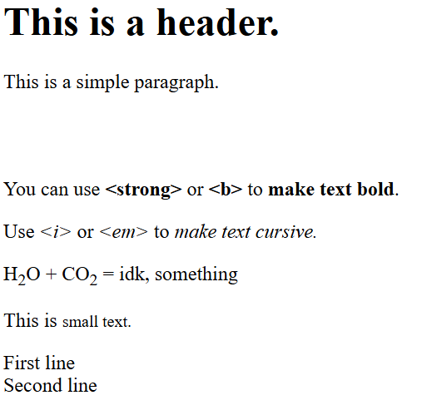
Tags
Tags for structuring and formatting text
<h1>, <h2>, … <h6> Headings
<p> Paragraph
Use these inside of <p> or <h> tags:
<b>, <strong> Bold text
<i>, <em> Italic text
<sub> Sub text
<small> Smaller text
<br> Line break
Notes:
Tags erklären (öffnender Tag und schließender Tag)

Slide 9
Practice
Exercise 1
Tasks:
Create an HTML file in Visual Studio Code (we’ll do this together).
Create a small overview about yourself using basic text and formatting tags.
This should contain your name, some information about job and your dual studies and a short About Me section.
Example:
Max Mustermann
Dual Student at Accenture
I’m studying Business Informatics in Dresden.
About me
Some personal information.
And some more.
Notes:
Tags erklären (öffnender Tag und schließender Tag)

Slide 10
Hypertext Markup Language
Headings
Headings (<h1> to <h6>) are used to create hierarchical structure in content.
They provide visual cues about the importance of text sections.
Hierarchy:
<h1> is the highest level and represents the main heading.
<h2> follows for subheadings, <h3> for sub-subheadings, and so on.
Semantic Meaning:
Headings not only affect appearance but also convey semantic meaning.
Search engines use headings to understand content structure.
Usage:
Use headings to organize content and guide readers through sections.
Avoid skipping heading levels for proper structure.
<h1>Main Heading</h1>
<p>Some introduction...</p>
<h2>Subheading 1</h2>
<p>Content...</p>
<h2>Subheading</h2>
<p>Content...</p>
<h3>Sub-subheading</h3>
<p>Content...</p>

Slide 11
Tags
Lists
Unordered Lists (<ul>):​
Create bullet-point lists.​
Use <li> (list item) tags for each item.​
Provides a visual hierarchy without indicating specific order.​
Ordered Lists (<ol>):​
Create numbered or ordered lists.​
Also use <li> tags for each item.​
Indicates a sequential or ranked order.​
Notes:
Tags erklären (öffnender Tag und schließender Tag)

Slide 12
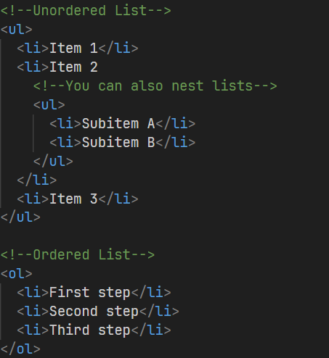
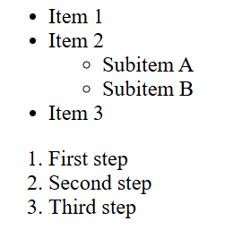
Tags
Lists Example
Notes:
Tags erklären (öffnender Tag und schließender Tag)

Slide 13
Tags
Anchor
Anchor tags, <a>, create hyperlinks to other web pages or resources.​
They enable navigation and linking within a webpage or to external content.​
Href Attribute:​
The href attribute specifies the destination URL for the link.​
Syntax: <a href=“url”>Text to be displayed</a>
Can be an absolute URL (e.g., http://www.example.com) or relative URL(/about.html).​
Target Attribute:​
The target attribute controls how the link is opened.​
"_blank" opens the link in a new tab or window.​
"_self" (default) opens the link in the same tab or window.​
Notes:
Tags erklären (öffnender Tag und schließender Tag)

Slide 14
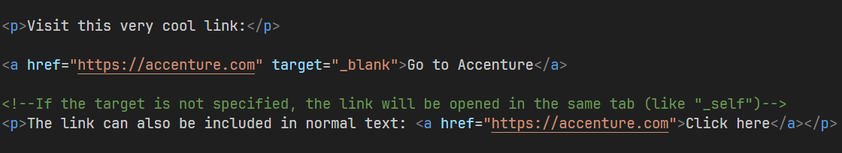
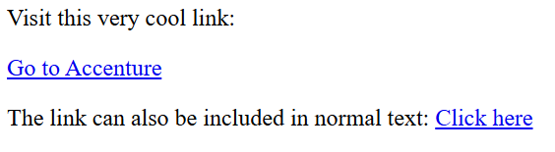
Tags
Anchor Example
Notes:
Tags erklären (öffnender Tag und schließender Tag)

Slide 15
Tags
Image
The <img> tag embeds images within web content.​
Src Attribute:​
The src attribute specifies the image file's source URL.​
Use an absolute URL or a relative path to the image file.​
Use the width and height attributes to scale the image.
​
Alt Attribute:​
The alt attribute provides alternative text for screen readers and if the imagecan't be displayed.​
Important for accessibility and SEO.​
Notes:
Tags erklären (öffnender Tag und schließender Tag)

Slide 16
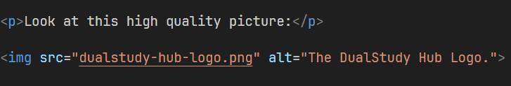
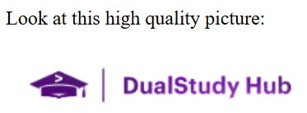
Tags
Image Example
Notes:
Tags erklären (öffnender Tag und schließender Tag)

Slide 17
Practice
Exercise 2
Tasks:
Add a list to your profile that includes your skills and one for your previous professional experience (like in a CV).
Add your profile picture (or any picture you want) below your name.
Add a link to your Workday Profile.
Example for a list:
Previous working experience:
Internship at Company XY
07/2026 – 08/2026
Part-time waiter at a restaurant
08/2025 – 05/2026
Notes:
Tags erklären (öffnender Tag und schließender Tag)

Slide 18
Tags
Structuring a website
To further structure a website, certain tags are used to split the website in sections.
These tags make the structure easier to understand for developers and browsers.
They help organizing content but are not mandatory to use.
Examples:
<header>: Used to give introductory content about the document.
<main>: Represents the main dominant content of a document.
<section>: Used to group together related items in the <main> part.
<footer>: Contains information such as Contact Information or Legal Disclosure.
Notes:
Tags erklären (öffnender Tag und schließender Tag)

Slide 19
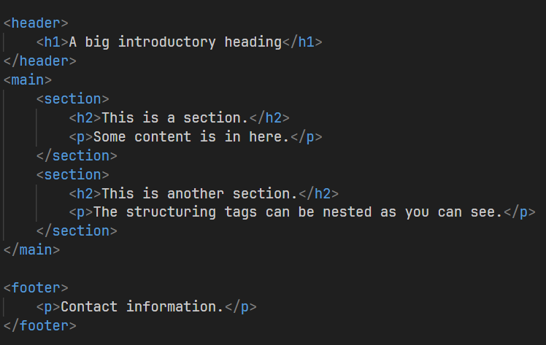
Tags
Structuring a website - Example
A simple website could have the following structure:
HEADER
-----------
MAIN
Section 1
Heading
Paragraph
Section 2
Content
-----------
FOOTER
Notes:
Tags erklären (öffnender Tag und schließender Tag)

Slide 20
Practice
Exercise 3
Task:
Add sections to your profile page to structure the content.
Use sections for the lists you created.
Add a small footer with some contact information.
Notes:
Tags erklären (öffnender Tag und schließender Tag)

Slide 21
CSS
Notes:
Including Accenture word

Slide 22
Cascading Style Sheets
Basics
Cascading Style Sheets (CSS) controls webpage appearance.
Separates design from content.
CSS enables visual design and layout control for web pages.
Example: accenture.com with and without CSS
Notes:
Bezug auf Beispiel „Aufbau eines Autos“
Nun auch Beleuchtung, Farben, Inneneinrichtung
… Funktionsweise (grob)
Accenture.com mit und ohne CSS

Slide 23
Cascading Style Sheets
Basic CSS Structure
Property
Value
CSS is written in separate files or within <style> tags in HTML.
Separate files enhance reusability and maintenance.
Selector:
Selects HTML elements to style.
Can be an element name, class, or ID.
Declaration Block:
Enclosed in curly braces {}.
Contains property-value pairs.
Property:
Specifies the aspect to style (e.g., color, font-size).
Value: Defines the style details (e.g., red, 16px).
Selector
/* External CSS File */
h1 {
color: blue;
font-size: 24px;
}
/* Internal CSS within <style> tags */
<style>
p {
font-family: Arial, sans-serif;
}
</style>

Slide 24
Cascading Style Sheets
Specification of CSS
CSS specifications can be defined in 3 ways:
inline, internal and external
Inline:
CSS statement is added as style attribute directly into the HTML element → not recommended
Internal:
All CSS statements are added to the header section of the HTML document within a style tag
External:
CSS statements are put into a separate file and linked in the header of the HTML document → recommended
<!–- inline -->
<h1 style=“color: blue”>H1</h1>
<!–- internal -->
<head>
<style>
h1 {color:blue;}
</style>
</head>
<!–- external -->
<head>
<link rel=“stylesheet” href=“style.css”>
</head>

Slide 25
Cascading Style Sheets
Specification of CSS
Usually, CSS is specified in an external file with the .css suffix.
To do this, the following syntax is used:
NOTE: For the <link> tag, no closing tag is needed.
The href attribute references the file similar to the src attribute of an <img> tag.
The rel attribute needs to be set to “stylesheet”.

Slide 26
Cascading Style Sheets
Styling Text with CSS
Font Family (font-family):
Determines the typeface for text.
Common values: Arial, Times New Roman, Helvetica.
Font Size (font-size):
Specifies the size of the text.
Can be in pixels, em, rem, or percentages.
Font Weight (font-weight):
Controls text thickness (boldness).
Values: normal, bold, bolder, lighter.
Text Color (color):
Sets the color of the text.
Use color names, hex codes, or RGB values.
Text Alignment (text-align):
Aligns text within its container.
Values: left, right, center, justify.
Text Decoration (text-decoration):
Adds visual effects to text.
Values: underline, overline, line-through, none.
Text Transform (text-transform):
Changes the text case.
Values: uppercase, lowercase, capitalize.
Line Height (line-height):
Controls the spacing between lines of text.

Slide 27
Cascading Style Sheets
Styling Areas with CSS
Background Color (background-color):
Sets the background color of an element.
Enhances contrast and visual appeal.
Background Image (background-image):
Places an image as the background of an element.
Use to add visual interest and branding.
Padding (padding):
Adds space inside an element's border.
Creates breathing room around content.
Margin (margin):
Adds space outside an element's border.
Controls spacing between elements.
Border (border):
Creates a border around an element.
Customize thickness, style, and color.
Width and Height (width / height):
Defines the dimensions of an element.
Control layout and alignment.
Display (display):
Determines how elements behave in layout.
Values: block, inline, inline-block, flex.
Position (position):
Controls element positioning in relation to its parent or the viewport.
Values: relative, absolute, fixed, static.

Slide 28
Cascading Style Sheets
Classes & IDs
To better address certain elements in the HTML, classes and IDs are used.
These can be referenced in CSS like .[class_name] or #[id_name].
Defining Classes:
A class is created as an attribute of an HTML tag.
Example: <p class=“annotation”>
Elements can have multiple classes. They are separated using a space.
Defining IDs:
If you want to uniquely address only one element, you can use IDs.
ID’s have to be unique and cannot be reused.
Example: <p id=“unique_text”>

Slide 29
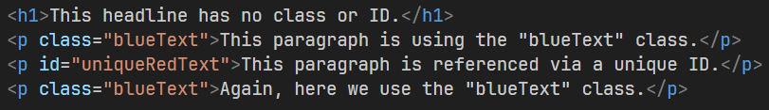
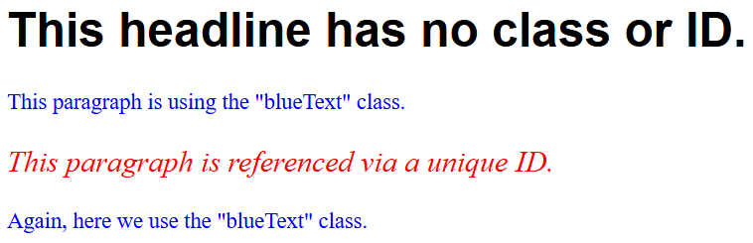
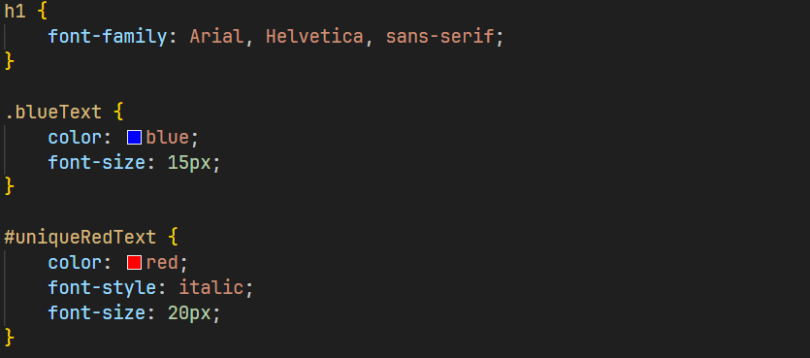
Cascading Style Sheets
Classes & IDs
Here is an example of how these can be used:

Slide 30
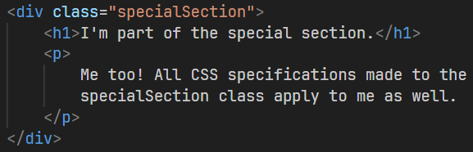
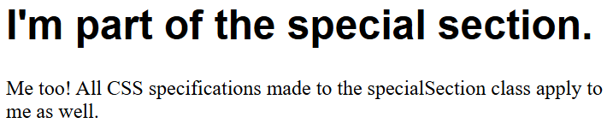
Cascading Style Sheets
Div-Containers
To further enhance the way of addressing certain groups of elements (for example a small box won a website), div-Containers are used in HTML.
These are used to group elements together without having a tag-specific functionality.
Address them using the <div> tag. Everything you want to include in this container will fit between the opening and closing tag.
Example:

Slide 31
Cascading Style Sheets
Specifying CSS
Multiple classes at once:
You can reference multiple CSS Selectors at once to apply styling to more than one class.
Syntax: h1, h2 { content }
Certain class elements:
You can also address only certain elements in a class. If for example, you want only the <p>-tags of your class to have a certain color, but not the <h3>-tags of that class.
Syntax: [tag].[class_name] { content }
There are many more ways to specify selectors. Some of them are listed on the following slide.

Slide 32
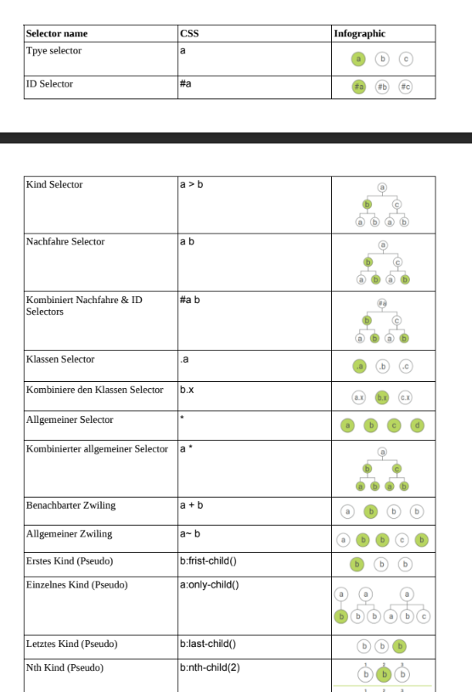
CSS Selectors
Chaining of CSS Selectors
Notes:
CSS Diner - Wo wir uns an CSS Selectors laben! (flukeout.github.io)

Slide 33
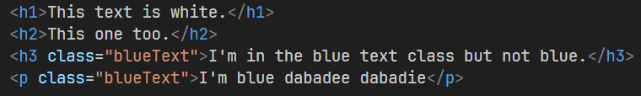
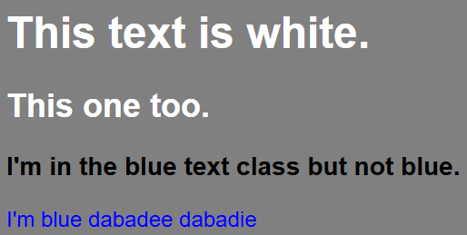
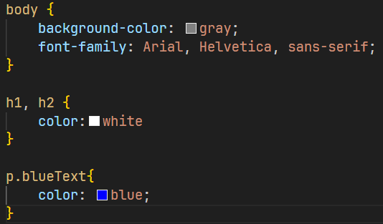
Cascading Style Sheets
Specifying CSS
Here is an example of some specified selectors:

Slide 34
Practice
Exercise 4
Task:
Add styling to your profile page.
Style your header in a different way than your main section and your footer.
Use classes and div-Containers to further classify your elements.
Notes:
Tags erklären (öffnender Tag und schließender Tag)

Slide 35
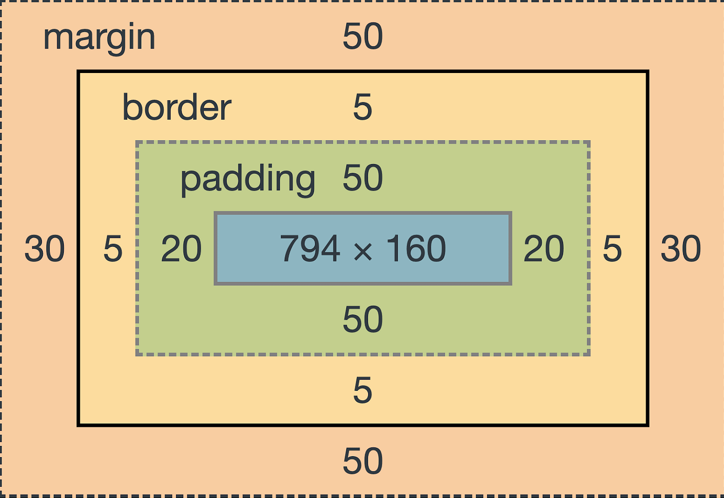
Cascading Style Sheets
Box Model
The box model represents how elements are structured in CSS.
Elements structured with content, padding, border, and margin.
Content: Element's actual content area.
Padding: Space between content and border.
Border: Surrounds padding and content.
Margin: Space outside the border.
Visualizing the Model: Imagine nesting boxes.
.box {
width: 200px;
height: 150px;
padding: 20px;
border: 2px solid black;
margin: 10px;
}

Slide 36
CSS Grid
.grid-container {
<!–- Application of the CSS
inline grid layout,
adapts to the content -->
display: inline-grid;
<!–- Application of the CSS
inline grid layout,
adapts to the content -->
display: inline-grid;
<!–- Creation of a grid layout with three equally sized columns-->
grid-template-columns: auto auto auto;
<!–- Size and columns manually customizable-->
}
A grid-based layout system for Web design
Two-Dimensional Layout: Manages both rows and columns.
Container-Based: Uses a grid container to define the grid.
Flexibility: Allows easy size and placement adjustments for elements.
Responsive Design: Adaptable for different screen sizes.
Placement Control: Precise control over the position of grid items.
Area Definition: Enables named areas in the grid for easy assignment.
Gap Management: Defines spaces between rows and columns.
Compatibility: Broadly supported in modern browsers.
Replaces Traditional Layouts: Reduces the need for floats and positioning.
Notes:
Beispiel Accenture Website

Slide 37
CSS Grid
A grid-based layout system for Web design
CSS
HTML
Box 1
Box 2
Box 3
.grid-container {
<!–- Application of CSS Grid Layout,
uses full size->
display: grid;
<!–- Creation of a grid layout with three equally sized columns-->
grid-template-columns: auto auto auto;
<!–- Size and columns manually customizable-->
}
<div class="grid-container">
<div class="grid-item">Box 1</div>
<div class="grid-item">Box 2</div>
<div class="grid-item">Box 3</div>
<div class="grid-item">Box 4</div>
<div class="grid-item">Box 5</div>
<div class="grid-item">Box 6</div>
<div class="grid-item">Box 7</div>
<div class="grid-item">Box 8</div>
<div class="grid-item">Box 9</div>
</div>
Box 4
Box 5
Box 6
Box 7
Box 8
Box 9

Slide 38
CSS Grid
A grid-based layout system for Web design
CSS
HTML
Box 1
Box 2
Box 3
.grid-container {
<!–- Application of the CSS
inline grid layout,
adapts to the content -->
display: inline-grid;
<!–- Creation of a grid layout with three equally sized columns-->
grid-template-columns: auto auto auto;
<!–- Size and columns manually customizable-->
}
<div class="grid-container">
<div class="grid-item">Box 1</div>
<div class="grid-item">Box 2</div>
<div class="grid-item">Box 3</div>
<div class="grid-item">Box 4</div>
<div class="grid-item">Box 5</div>
<div class="grid-item">Box 6</div>
<div class="grid-item">Box 7</div>
<div class="grid-item">Box 8</div>
<div class="grid-item">Box 9</div>
</div>
Box 4
Box 5
Box 6
Box 7
Box 8
Box 9

Slide 39
CSS Grid
A grid-based layout system for Web design
.grid-container {
<!–- Application of CSS Grid Layout,
uses full size->
display: grid;
<!–- Defines named areas
within the grid ->
grid-template-areas:
‘item1 item1 item1'
‘item2 item3 item4'
‘item2 item5 item5’;
<!–- Assigns the classes to
the grid areas,
for example to link
box-1 with item1. ->
.box-1 { grid-area: item1; }
.box-2 { grid-area: item2; }
.box-3 { grid-area: item3; }
.box-4 { grid-area: item4; }
.box-5 { grid-area: item5; }
}
CSS
HTML
Box 1
<div class="grid-container">
<div class=„box-1">Box 1</div>
<div class=„box-2">Box 2</div>
<div class=„box-3">Box 3</div>
<div class=„box-4">Box 4</div>
<div class=„box-5">Box 5</div>
</div>
Box 2
Box 3
Box 4
Box 5

Slide 40

CSS Flexbox
Task: Play the game Flexboxfroggy (https://flexboxfroggy.com/#de)
Notes:
Simply search for Flexboxfroggy on google or https://flexboxfroggy.com/#de
Solutions:
justify-content: flex-end;
justify-content: center;
justify-content: space-around;
justify-content: space-between;
align-items: flex-end;
align-items: center;
justify-content: center;
flex-direction: row-reverse;
flex-direction: column;
flex-direction: row-reverse;
justify-content: flex-end;
flex-direction: column-reverse;
flex-direction: row-reverse;
order: 1;
order: -3;
align-self: flex-end;
align-self: flex-end; order: 1;
flex-wrap: wrap;
flex-direction: column; flex-wrap: wrap;
flex-flow: column wrap;
align-content: flex-start;
align-content: flex-end;
flex-direction: column-reverse; align-content: center;
flex-flow: column-reverse wrap-reverse; justify-content: center; align-content: space-between;

